Slide 1


Introduction to Ethereum
Ethereum, Network Components, Ethers, Blocks, Transactions, Gas, Problems, Solutions
Sevgin Mustafov
Blockchain Developer & Course Developer
Academy School of Blockchain
http://kingsland.academy

Slide 2


Table of Contents
Ethereum vs Bitcoin
What is Ethereum?
Who Created Ethereum?
How Ethereum Works?
Main Components of Ethereum System
What is Ether?
Ethereum Problems
How Will Ethereum Scale?

Slide 3

Ethereum
Introduction to Ethereum Blockchain

Slide 4

Blockchain Definition
Cryptographically secure
Digital currency - secured by complex mathematical algorithms
Transactional singleton machine
Responsible for all the transactions
With shared-state
State stored on this machine is shared and open

Slide 5
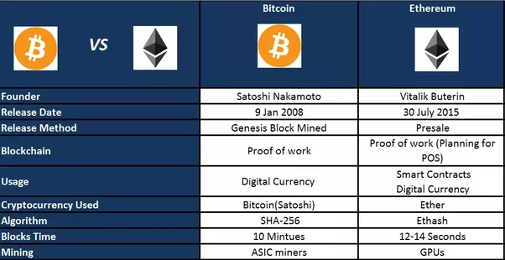
Ethereum vs Bitcoin

Slide 6
What is Ethereum?
Ethereum – popular blockchain network
Distributed computing platform with smart contract functionality
Open-source, public project
Provides a cryptocurrency coin – “ether”
Ethereum fork: Ethereum vs. Ethereum Classic
Caused by the collapse of " The DAO" project

Slide 7

Who Created Ethereum?
Vitalik Buterin
Cryptocurrency researcher & developer
Co-founder of Bitcoin Magazine
Learn more at: https://about.me/vitalik_buterin
The Ethereum whitepaper (2013)
"A Next Generation Smart Contract & Decentralized Application Platform" by Vitalik Buterin – https://goo.gl/Xgdfgk
Ether sale ICO (2014) raised 14M USD (~32K BTC)
In 30 July 2015 the main net launched – etherscan.io/block/0

Slide 8
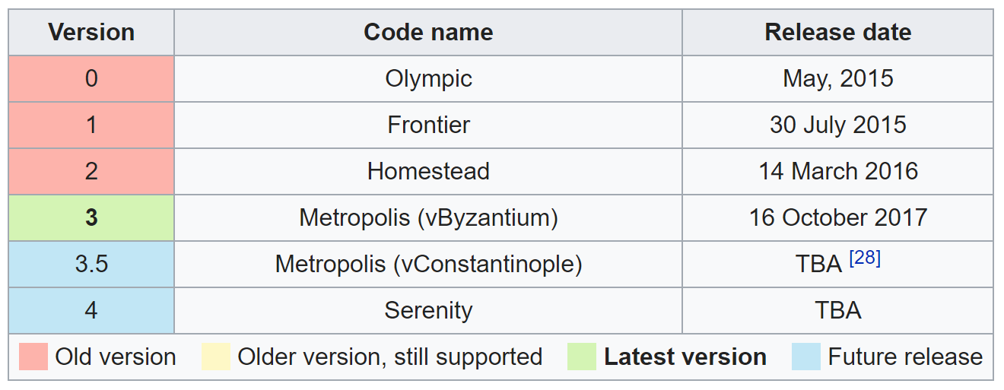
Ethereum Milestones

Slide 9
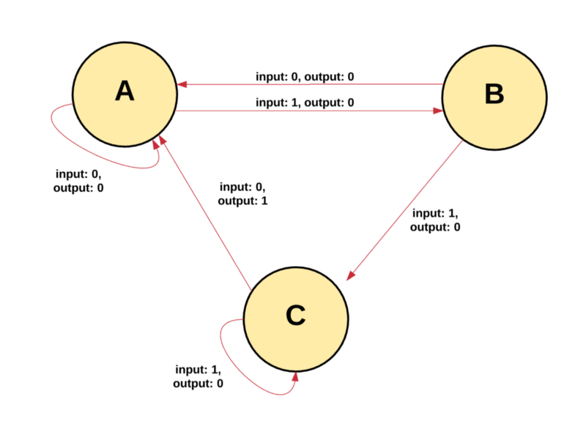
Ethereum Blockchain Paradigm
Transaction-based state machine
Transition to a new state by reading a series of inputs
Ethereum transactions transit from one state to another

Slide 10
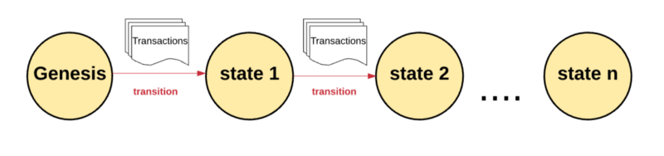
Ethereum Blockchain Paradigm (2)
Begins with a “genesis state”
Transaction execution generates a new state
The blockchain holds all states of the Ethereum network over the time – see https://etherscan.io/txs

Slide 11
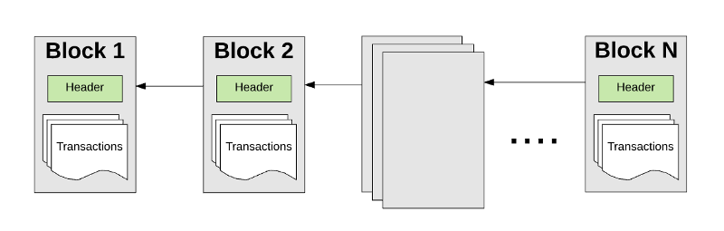
Ethereum Blockchain Paradigm (3)
Transactions are grouped into “blocks”
Contains a series of transactions
Block is chained together with its previous block

Slide 12
Ethereum Blockchain Paradigm (4)
To validate a transaction - must go through a validation process a.k.a. mining
Fastest miner adds block to the main blockchain
Rewarded with a certain amount of Ethers
Validating block – “proof of work”

Slide 13
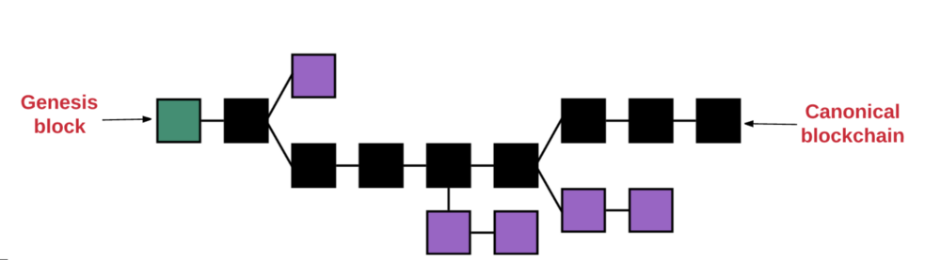
GHOST Protocol
GHOST == Greedy Heaviest Observed SubTree
Pick the path, which has most computation done upon it
Determine that path
Use the block number of the most recent block
Higher the block number, the longer the path
Agree on the canonical version of the current state

Slide 14
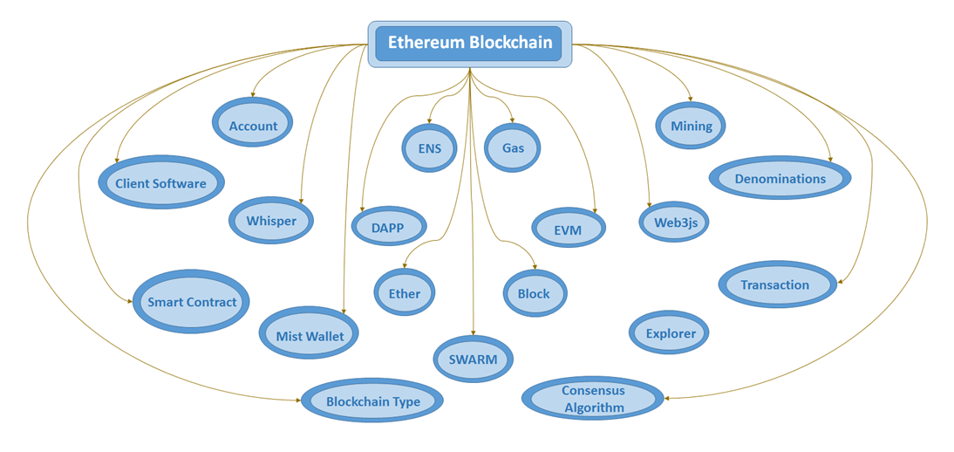
Main Components of Ethereum System
Nodes – http://ethernodes.org
Accounts – https://etherscan.io/accounts
Blocks – https://etherscan.io/blocks
Transactions – https://etherscan.io/txs
Transaction execution
Gas, gas price and fees
State – https://ethstats.net
Mining & Proof-of-Work

Slide 15

What is Ether?
Ether == value coin of the Ethereum blockchain
Code – ETH
Traded on cryptocurrency exchanges
Pay in ETH for:
Transaction fees
Computational services (gas to execute smart contract's code)
Market price: coinmarketcap.com/currencies/ethereum/

Slide 16

Ethereum Problems: Scalability
Processing around 5 - 6 transactions/second
VISA processes around 2000 transactions/second
Due to the manner in which transactions are validated
Maintain a copy of the blockchain
Process each transaction made on it

Slide 17
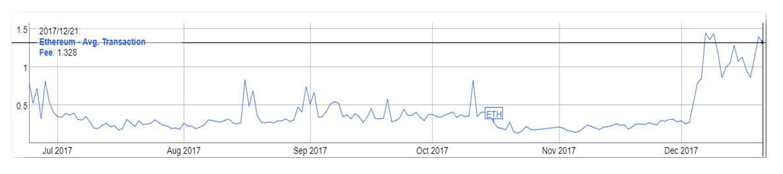
Ethereum Problems: Transaction Costs
Transactions in Ethereum can be very expensive
cost = gasConsumed * gasPrice
E.g. 210 000 gas * 20 GWei/gas = 0.0042 ETH * 600 USD/ETH = 2.52 USD per transaction
Gas price == how much Ether the user is willing to pay per gas

Slide 18


Ethereum Problems: Oracles Problem
In blockchain networks an oracle is provider of data
Gives to smart contracts answers to questions about the world
E.g. what is the price of BTC or what is the temperature in Sofia
Holds the power to control what the smart contract does
Centralized vs. decentralized oracles
In search of the perfect oracle
Augur – http://www.augur.net
Gnosis – https://gnosis.pm

Slide 19
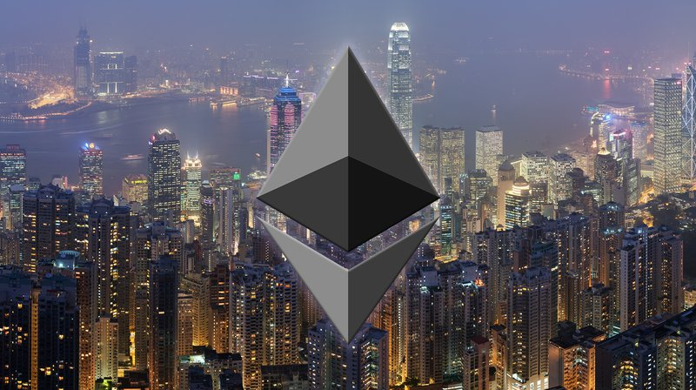
How will Ethereum Scale?
Sharding
Breaks database into pieces
Puts each part on a different server
Move away from “full” nodes
Process isn't exactly trustless
Off-chain transactions
Made on off-chain micropayment channels
Lifting from the underlying blockchain
Can be back to the blockchain anytime

Slide 20


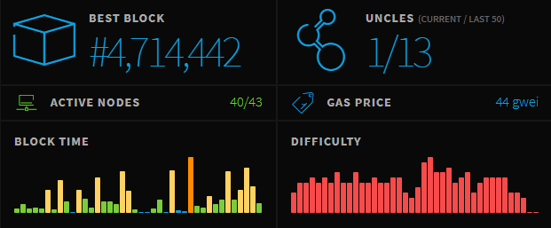
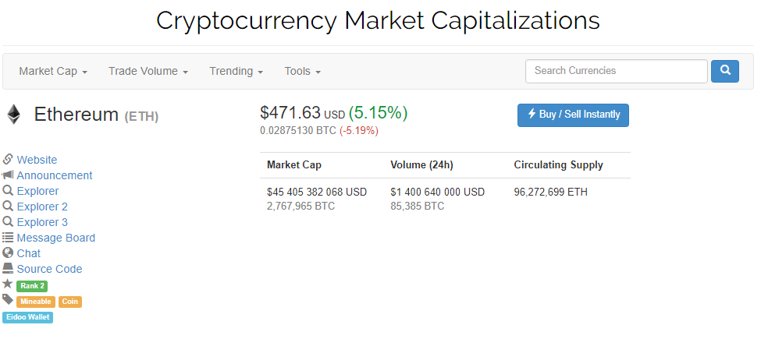
Ethereum Useful Resources
Ethereum Project Website
https://www.ethereum.org
Ethereum Block Explorer
https://etherscan.io
Ethereum Stats
https://ethstats.net
Ethereum Cryptocurrency
https://coinmarketcap.com/currencies/ethereum/

Slide 21
Geth and Mist – Official Ethereum Clients
Ethereum client
A software designed to interact with the Ethereum network
Might implement a wallet to keep addresses + private keys
Example Ethereum clients: geth, parity, pyethapp
Geth – https://geth.ethereum.org
Console-based Ethereum client, node and wallet
Mist – https://github.com/ethereum/mist
GUI for the Geth client
Browse and use DApps on the Ethereum network

Slide 22
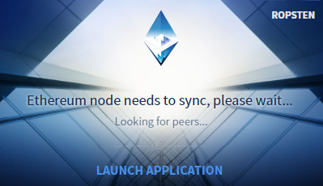
Exercise
Playing with Geth and Mist

Slide 23

Summary
Ethereum is blockchain-based distributed computing platform
Ethereum’s creator is Vitalik Buterin and few others
Smart contracts, running in the EVM, written in Solidity
Ether is value coin of the Ethereum blockchain
Geth and Mist are the official console-based and GUI clients
Major problems at the Ethereum blockchain
Scalability, performance and transaction costs
Possible solutions: sidechains and off-chain transactions

Slide 24
Introduction to Ethereum
http://www.kingsland.academy

Slide 25
Resources
What is Ethereum: https://coindesk.com/information/what-is-ethereum/
How Ethereum Works: https://medium.com/@preethikasireddy/how-does-ethereum-work-anyway-22d1df506369
How to Use Ethereum: https://www.coindesk.com/information/how-to-use-ethereum/
What is Ether: https://www.coindesk.com/information/what-is-ether-ethereum-cryptocurrency/
How will Ethereum Scale: https://www.coindesk.com/information/will-ethereum-scale/
Scalability: https://www.mycryptopedia.com/sharding-the-solution-to-ethereums-scalability-problem/
The Oracle Problem: https://ether.direct/2017/07/15/the-oracle-problem/

